Slide 2




NOTARY: STATE OF THE CONTAINER SUPPLY CHAIN
Steve Lasker
Principal PM Architect
Azure Container Registries
Steve.Lasker@Microsoft.com
@SteveLasker
SteveLasker.blog
github.com/SteveLasker
github.com/SteveLasker/presentations
Justin Cormack
CTO
Docker
justin@docker.com
@justincormack
cloudatomiclab.com
github.com/justincormack

Slide 3
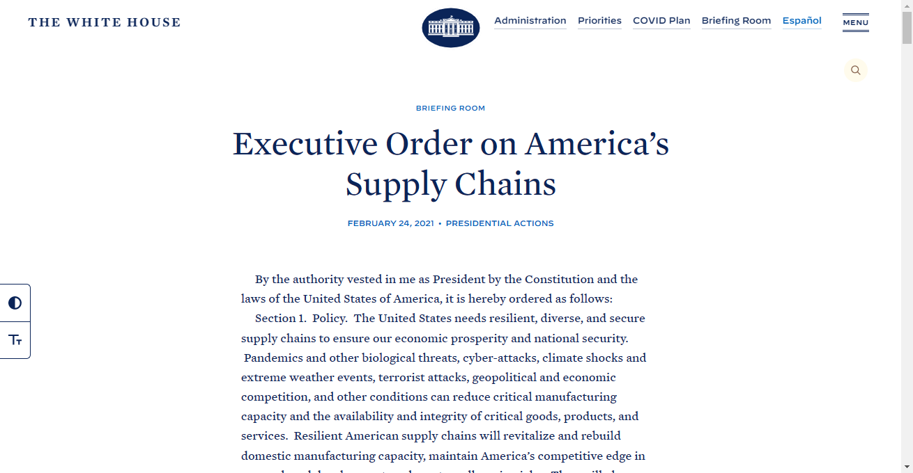
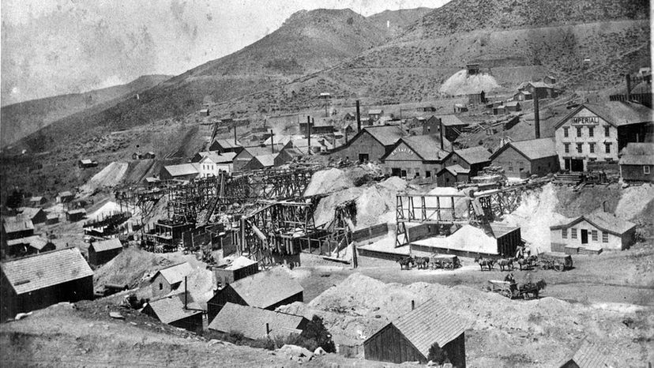

State of the Container Supply Chain
There are multiple efforts
Focusing on different stages of the supply chain
Some overlap
Innovation happening at the speed of …
Notes:
http://www.internethistorypodcast.com/2017/01/the-history-of-the-dotcom-bubble/

Slide 4
Stages of the Supply Chain
Creation of Content
The building of content (binaries, packages, images)
Distribution of Content
Distributing the content to consumers
Distribution includes promotion across different environments
Consumption of Content
To build other content
To import from other sources
To deploy
Notary v2

Slide 5
Notary v2 Focus
Signing any and all artifacts, distributed through an OCI Distribution based registry
Attesting to the content, based on an entity you trust
Focused on the distribution and consumption stages Creation stage, from the point it consumes distributed content
Location independence, enabling signatures to travel with the artifacts they’ve signed, supporting promotion within and across any OCI/ORAS Artifact conformant registry

Slide 6
Notary Log
Signing – what does it promise?
What are you signing, and verifying, (Public or Custom Content)
Identity & Location – are these coupled concepts?
Are signatures enough?
Validating across environments – what about Vnet and Air Gap
Promoting Artifacts how to validate it should be promoted? how do you promote?
Revocation where and how is revocation important?

Slide 7
How Do You Deploy Today?
Unique tags? (my-service:ag-123)
Digests? (my-service@sha256:abs8a23823aaa8a8d8d8a...)
Convert a tag to a digest?
What do digests promise?
Do you track all the digests created, and who created them?

Slide 8
Signing – what does it promise?
“All deployed content must be signed”
By who?
Who do you trust?
Who don’t you trust?
Who do you/don’t you trust for a given environment?
If you had signed content, from entities you trust, would you need to track individual digests?

Slide 9
Signing – what does it promise?
Signing is a means to associate the state of an artifact with an entity
You choose to trust that entity, for a given environment
The attesting entity you trust may change across environments

Slide 10
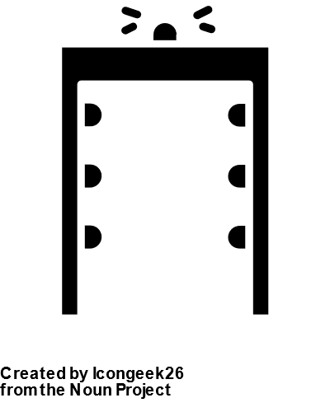
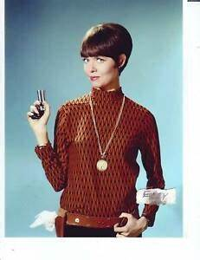

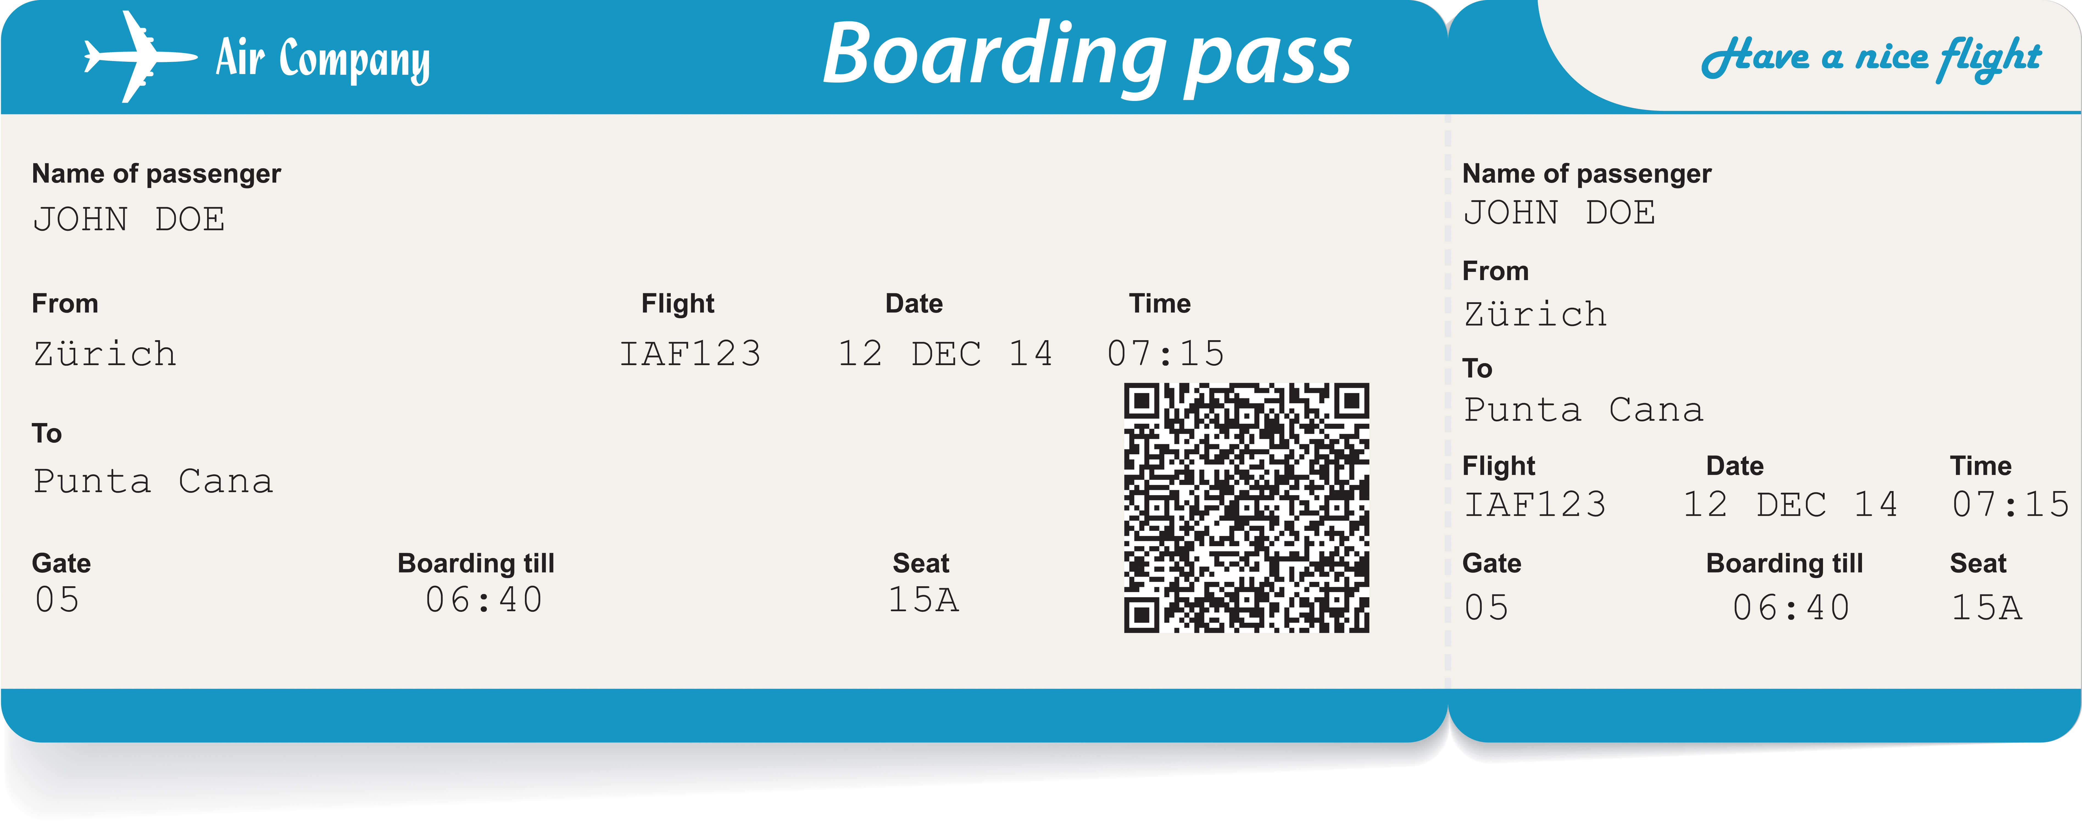

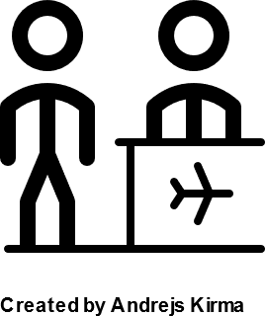

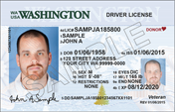
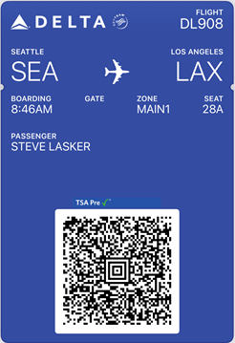
Attesting To Entity Promotion
Checking Into the Airport
TSA Agent 99
Gate
Agent 44
Plane
Agent 99
Agent 99
Agent 44
Agent 99
Agent 99
Agent 44
Notes:
TSA Agent created by Berkah Icon
Traveler by Yamin Alanis, from the noun projectd
Airline Gate Agent by Andrejs Kirma from the Noun Project

Slide 11

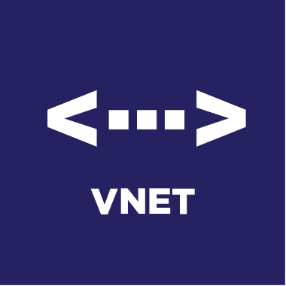

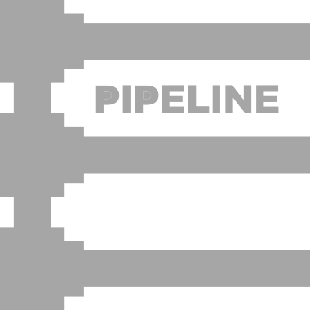

Artifact Promotion
Wabbit Networks
Docker Hub ^{(Distributor)}
ACME Rockets
Air-gapped network
Artifact Build Environment
Trust Policy
Wabbit Networks
Docker Hub
Image
Spacely Sprockets
Image
Image
Image
Image
Image
Image
Image
Cogswell Cogs
Internal Registry
Private Registry
Container Host
SBoM
SBoM
SBoM
SBoM
SBoM
SBoM
SBoM
SBoM
Policy Management
Scan Results
Scan Results
Scan Results
Scan Results
Scan Results
Scan Results
Scan Results
Scan Results
src
src
src
src
src
src
src
src
Air-gapped network
Spacely Sprockets
Spacely Sprockets
Artifact Build Environment
Private Registry
Container Host
Policy Management
Image
Image
Image
SBoM
SBoM
SBoM
Scan Results
Air-gapped network
Scan Results
Scan Results
Cogswell Cogs
Artifact Build Environment
Private Registry
Container Host
Policy Management
Image
Image
SBoM
SBoM
Scan Results
Scan Results

Slide 12




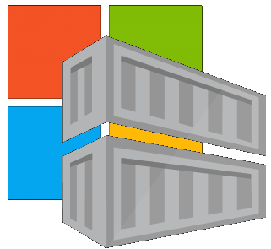
Location Independence
Which Public Registry, for which content?
docker hub
ecr public
your registry
mcr
github

Slide 13


Location Independence
Promote the content you trust to a location you trust
Public
ACME Rockets
Shared Internal
Dev
Staging
Prod
Dev
Staging
Prod

Slide 14
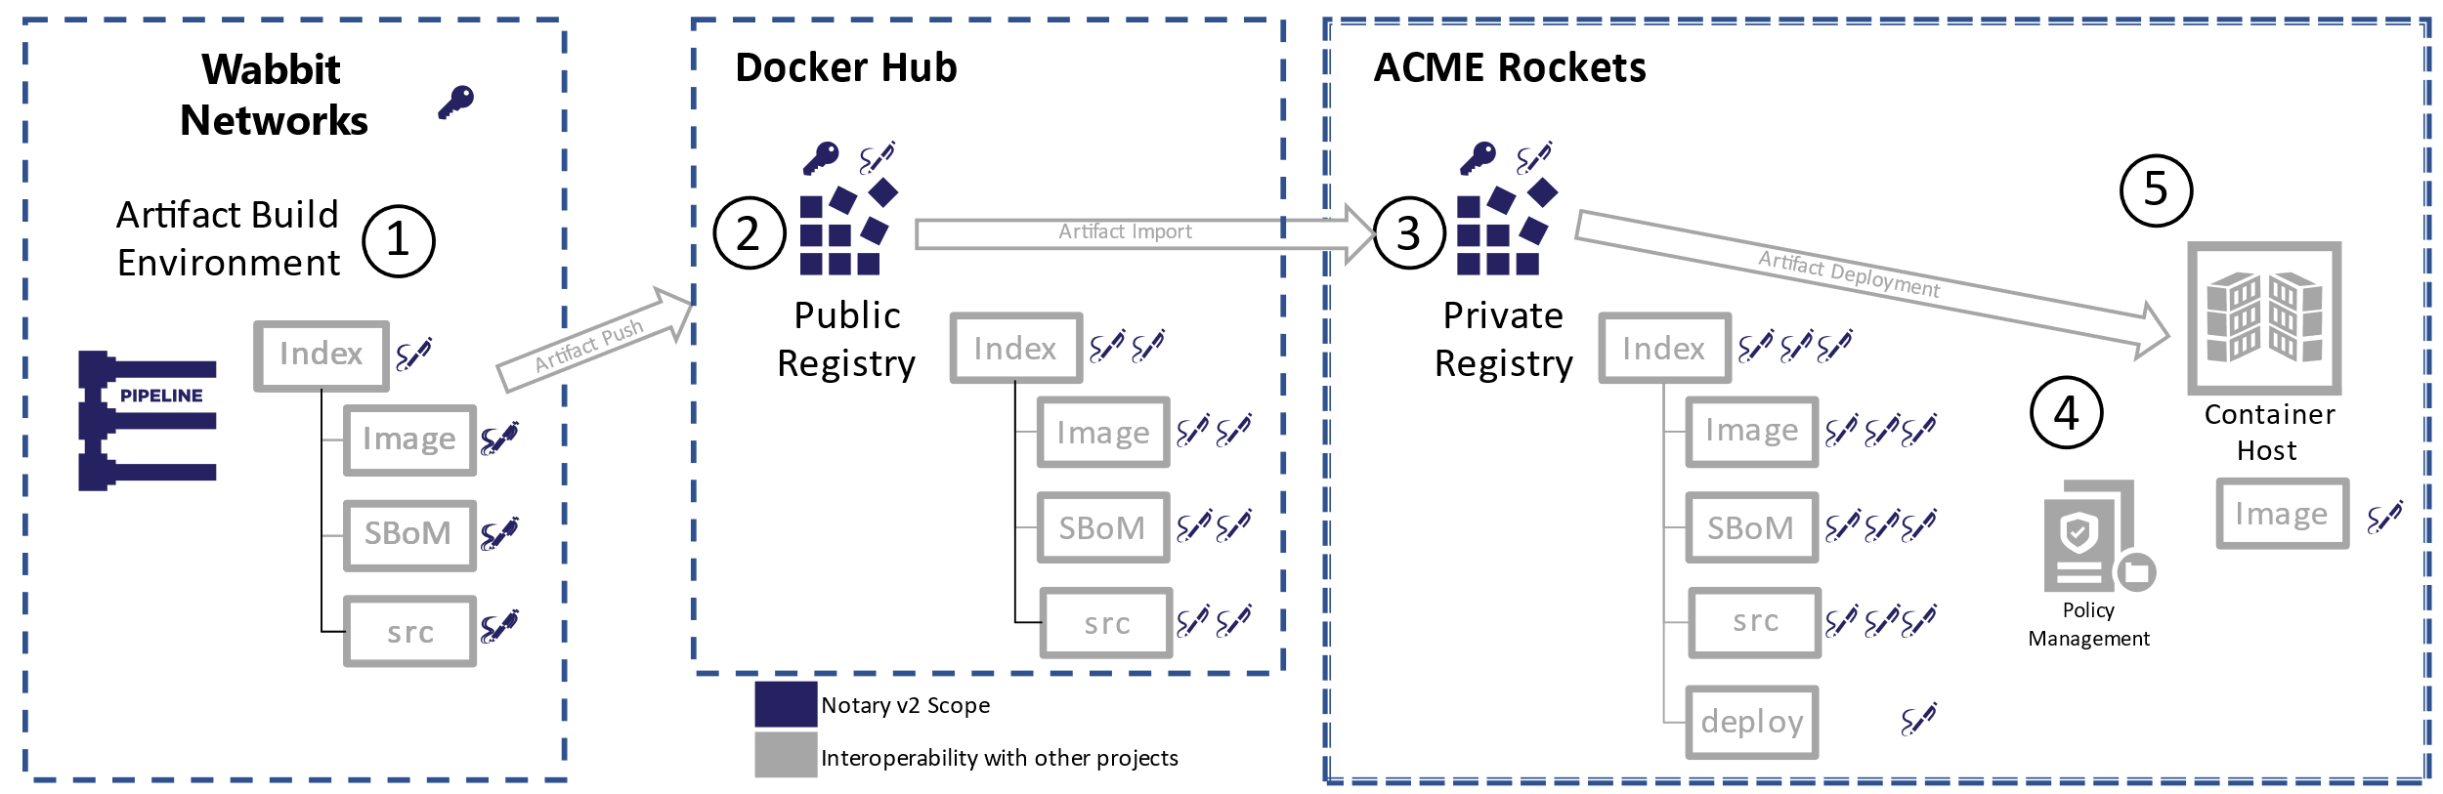
Supply Chain Artifact Challenges
Artifacts are promoted across environments
Pubic → Shared Internal → Dev → Staging → Prod
Many of these destinations are within restricted networks (Vnets)
The supply chain objects should travel with the artifacts
Enabling evaluation and validation of the supply chain objects, where the content is consumed from

Slide 15
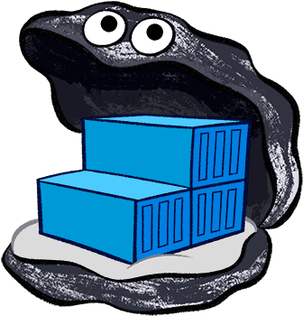
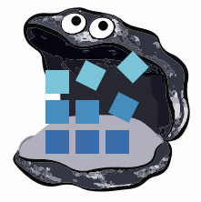












YASS
Container Registries
→ Artifact Registries
!
Y
Yet
Another
Storage
Solution
A
S
S

Slide 16
Registries & Reference Types
Registries are ubiquitous across all cloud providers
Cloud, On-Prem, IoT
Support performance, reliability, security capabilities from dev→prod
Users want fewer services to run, configure & maintain
Artifact authors want to focus on their thing
Does the SPDX, CycloneDX, Foo Community want to design, spec, build, operate Yet Another Storage Service?

Slide 17
Artifact: Reference Type Principals
Multiple artifacts exist, and none should have to create YASS
Persisted alongside the subject artifact
Solves the discovery problem & network isolated/air-gapped environments
Reference Types artifacts can be copied with the target artifact
Associated with, but separable from the target artifact
Solves the trojan horse validation challenge
Target artifact must not change when adding new artifacts
docker pull mcr.microsoft.com/dotnet/runtime:5.0
docker pull mcr.microsoft.com/dotnet/runtime@sha256:ca9c27f79cfc669d74befcd93f
Helm chart references
Kubedeploy.yaml references
1- YASS- Yet Another Storage Service

Slide 18




Attesting To Entity Promotion
TSA Agent 99
Agent 44
Plane
Agent 99
Notes:
TSA Agent created by Berkah Icon
Traveler by Yamin Alanis, from the noun projectd
Airline Gate Agent by Andrejs Kirma from the Noun Project

Slide 19
Identity & Location
Does location infer identity?
Should identity be associated with location?
Does the path of an artifact matter if it’s proven to be the same as when it was created?
Can you trust the unique identity?
Signing enables
Trust of the entity that attested to the artifact, regardless of location

Slide 20
How Notary v2 Enables Secure Workflows
Signatures are associated with a subject artifact
Signatures are promoted with the artifact
Multiple signatures may be associated with a given artifact
Signatures are separable, enabling protection from trojan horse attacks

Slide 21


net-monitor:v1
mediaType: oci.image.manifest
config (blob)
layer1 (blob)
layer2 (blob)
wabbit-networks signature
mediaType: cncf.oras.artifact.manifest.v1
artifactType : org.cncf.notary.v2
signature [blobs]
reference (subject)
ACME Rockets Registry
docker-certified signature
Reference types enable adding artifacts which refer to a subject artifact
mediaType: cncf.oras.artifact.manifest.v1
artifactType : org.cncf.notary.v2
net-monitor:v1
mediaType: oci.image.manifest
signature [blobs]
config (blob)
reference (subject)
layer1 (blob)
acme-rockets-library signature
docker push net-monitor:v1
layer2 (blob)
mediaType: cncf.oras.artifact.manifest.v1
artifactType : org.cncf.notary.v2
wabbit-networks signature
signature [blobs]
mediaType: cncf.oras.artifact.manifest.v1
artifactType : org.cncf.notary.v2
reference (subject)
signature [blobs]
acme-rockets-dev-a signature
notation sign net-monitor:v1 (notation cli incorporates push as a reference type)
reference (subject)
mediaType: cncf.oras.artifact.manifest.v1
artifactType : org.cncf.notary.v2
SBoM Document
signature [blobs]
mediaType: cncf.oras.artifact.manifest.v1
artifactType: org.spdx.sbom.v3
reference (subject)
sbom [blobs]
acme-rockets-staging-h signature
reference (subject)
mediaType: cncf.oras.artifact.manifest.v1
artifactType : org.cncf.notary.v2
spdx report --push net-monitor:v1
(sbom cli could incorporate notation sign and oras-go push|discover|pull)
wabbit-networks signature
signature [blobs]
mediaType: cncf.oras.artifact.manifest.v1
artifactType: org.cncf.notary.v2
reference (subject)
signature [blobs]
acme-rockets-prod-h signature
reference (subject)
mediaType: cncf.oras.artifact.manifest.v1
artifactType : org.cncf.notary.v2
signature [blobs]
reference (subject)

Slide 22
Demo
Signing and Validation
Notes:
Create a private/public key combination
Store in a private keyvault
Biuld an image
Retrieve the private key
Sign the image
Create an SBoM
Sign the SBoM
Scan the image
Associate the scan results
Sign the scan results
Sign the image with a scanned signature
Push the image
With the signatures, scan results and sbom
Promote to Production
Verify the signature
Verify the scan results & SBoM
Sign the image, with a prod signature (note, the image didn’t get pulled to add the signature)
Copy the

Slide 23
Promoting Artifacts
How to promote a graph of artifacts?
Several tools were used to create various artifacts
Container Build Tools (Docker)
SBoM Creation (CycloneDX, SPDX)
Image Scan Results (Aqua, Palo Alto, Snyk)
Signatures (Notary, Cosign)
Should each tool be used to promote the graph?

Slide 24
ORAS Artifacts
net-monitor:v1
mediaType: oci.image.manifest
config (blob)
layer1 (blob)
layer2 (blob)
Enhances OCI Registries to understand graphs of content
Artifacts are pushed with a subject, linking to another artifact
Signatures → container images
SBoMs → container images
Signatures → SBoMs
Scan Results → Container images
Signatures → Scan Results
wabbit-networks signature
mediaType: cncf.oras.artifact.manifest.v1
artifactType : org.cncf.notary.v2
signature [blobs]
ACME Rockets Registry
reference (subject)
docker-certified signature
net-monitor:v1
mediaType: cncf.oras.artifact.manifest.v1
artifactType : org.cncf.notary.v2
mediaType: oci.image.manifest
signature [blobs]
config (blob)
reference (subject)
layer1 (blob)
layer2 (blob)
acme-rockets-library signature
wabbit-networks signature
mediaType: cncf.oras.artifact.manifest.v1
artifactType : org.cncf.notary.v2
mediaType: cncf.oras.artifact.manifest.v1
artifactType : org.cncf.notary.v2
signature [blobs]
signature [blobs]
reference (subject)
reference (subject)
acme-rockets-dev-a signature
SBoM Document
mediaType: cncf.oras.artifact.manifest.v1
artifactType : org.cncf.notary.v2
mediaType: cncf.oras.artifact.manifest.v1
artifactType: org.spdx.sbom.v3
signature [blobs]
sbom [blobs]
reference (subject)
reference (subject)
acme-rockets-staging-h signature
wabbit-networks signature
mediaType: cncf.oras.artifact.manifest.v1
artifactType : org.cncf.notary.v2
mediaType: cncf.oras.artifact.manifest.v1
artifactType: org.cncf.notary.v2
signature [blobs]
signature [blobs]
reference (subject)
reference (subject)
acme-rockets-prod-h signature
mediaType: cncf.oras.artifact.manifest.v1
artifactType : org.cncf.notary.v2
http://github.com/oras-project/artifacts-spec/
signature [blobs]
reference (subject)

Slide 25
Demo
oras copy wabbit-networks.io/net-monitor:v1 \
acme-rockets.io/net-monitor:v1 -r
registry.wabbit-networks.io/net-monitor:v1 ├── application/vnd.cncf.notary.v2 │ └── sha256:8c0e82624475a4ad64ddca2d68c0f82e316ec758591cb916049fe59eaf27b5b4 ├── application/vnd.org.snyk.results.v0 │ └── sha256:95b97532a5b2d0c36cfcefd403b02779fb5afca07479a66bd509a635d5681e7f │ └── application/vnd.cncf.notary.v2 │ └── sha256:02f35a789d1ec2267727ac32c4f8ad643e88288528e648e4b71af42c2912699b └── sbom/example └── sha256:82d89db16266d13ab7680badfea3dbd91fd8e311c3b4291d9c0d4f9cff86fa50 └── application/vnd.cncf.notary.v2 └── sha256:413e8b4de5f09c1b458d9d0ab8f1cc510d4276ffaa710073daff721e89b07aa2
oras copy [source] [destination] --recursive
Notes:
Validate the signature of the source
Show list of repositories in target – none
IF → copy the graph
Show the list ore repositories in the target
Show list of tags

Slide 26
Existing Registry Support
How to promote ORAS Artifacts across registries
ORAS will support a fallback
Not as good, but allows usage, until the registry supports ORAS Artifacts
Will work for Notary v2 signatures, and all other reference types

Slide 27
Notary v2 Policy Management
Notary v2 enables policy-based management, per environment
You configure which keys you trust, per environment
Integrate with OPA/Gatekeeper and other policy managers
Notary v2 supports key provider extensibility

Slide 28
Wait, There’s More
Key and Signature Revocation
Important for public content
Private content is under private control
TUF Integration
Working through cross registry promotion scenarios
OCI Distribution 1.0 Registry Fallback
Notary and ORAS will have degraded fallback support

Slide 29
Wrapping Up
Signatures enable attestation of an artifact by a given entity
You choose which entities you trust, for each environment
As you promote, stamp with a signature for that environment
Notary v2 references, generalized for all supply chain reference types
ORAS enables promoting a graph of artifacts into the environment you trust
…and have access to

Slide 30
Thank You
Notary v2: github.com/notaryproject/notaryproject
OCI Artifacts: github.com/opencontainers/artifacts
ORAS Artifact Reference Types: github.com/oras-project/artifacts-spec
ORAS CLI: github.com/oras-project/oras
ORAS Library: github.com/oras-project/oras-go
CNCF Distribution Reference Types: github.com/oras-project/distribution
Steve Lasker
Principal PM Architect
Azure Container Registries
Steve.Lasker@Microsoft.com
@SteveLasker
SteveLasker.blog
github.com/SteveLasker
github.com/SteveLasker/presentations
Justin Cormack
CTO
Docker
justin@docker.com
@justincormack
cloudatomiclab.com
github.com/justincormack

Slide 31
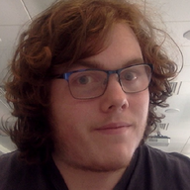

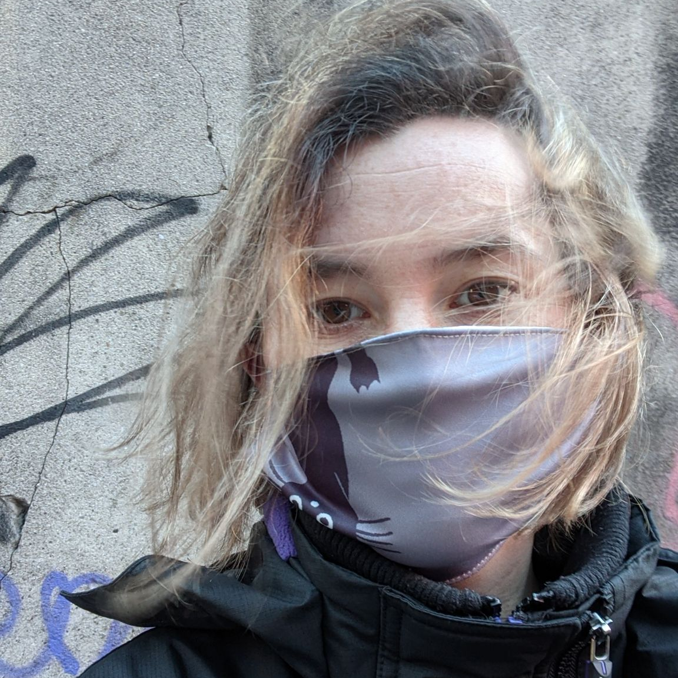

Secure your cluster to cluster traffic, the agnostic way
Photo
October 11-15, 2021
Dave Kerr Software Engineer Workday
Pauline Lallinec Software Engineer Workday
Notes:
This slide is for marketing + promoting your talk! Please select the appropriate slide for your talk type: Two-speakers, One-Speaker or Panel + add your talk and speaker details to the slide. To add a photo(s): Right click on the image placeholder and select replace and upload a photo. You can then save the individual slide as an image to use when tweeting or sharing on LinkedIn or Facebook. Please email cncfcolocatedevents@cncf.io if you have any questions.

Slide 32
Title
October 11-15, 2021
Speaker Name Job Title Company
Notes:
This slide is for marketing + promoting your talk! Please select the appropriate slide for your talk type: Two-speakers, One-Speaker or Panel + add your talk and speaker details to the slide. To add a photo(s): Right click on the image placeholder and select replace and upload a photo. You can then save the individual slide as an image to use when tweeting or sharing on LinkedIn or Facebook. Please email cncfcolocatedevents@cncf.io if you have any questions.

Slide 33
Title
Speaker Name Job Title Company
Speaker Name Job Title Company
Speaker Name Job Title Company
October 11-15, 2021
Speaker Name Job Title Company
Speaker Name Job Title Company
Notes:
This slide is for marketing + promoting your talk! Please select the appropriate slide for your talk type: Two-speakers, One-Speaker or Panel + add your talk and speaker details to the slide. To add a photo(s): Right click on the image placeholder and select replace and upload a photo. You can then save the individual slide as an image to use when tweeting or sharing on LinkedIn or Facebook. Please email cncfcolocatedevents@cncf.io if you have any questions.

